Slide 1
Unit 3 Support Vector Machine (SVM)

Slide 2
Topics to be covered...
Introduction to SVM
Concept of maximum margin hyperplane
Linear SVM
1 Calculation of MMH
2 Learning a linear SVM
3 Classifying a test sample using linear SVM
4 Classifying multi-class data
Non-linear SVM
Concept of non-linear data
Soft-margin SVM
Kernel Trick

Slide 3
Introduction
A classification that has received considerable attention is support vector machine and popularly abbreviated as SVM.
This technique has its roots in statistical learning theory (Vlamidir Vapnik, 1992).
As a task of classification, it searches for optimal hyperplane(i.e., decision boundary, see Fig. 1 in the next slide) separating the tuples of one class from another.
SVM works well with higher dimensional data and thus avoids dimensionality problem.
Although the SVM based classification (i.e., training time) is extremely slow, the result, is however highly accurate. Further, testing an unknown data is very fast.
SVM is less prone to over fitting than other methods. It also facilitates compact model for classification.

Slide 4
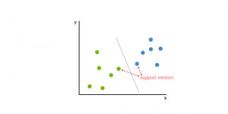
OBJECTIVES
Support vector machines (SVM) are supervised learning models with associated learning algorithms that analyze data used for classification and regression analysis.
It is a machine learning approach.
They analyze the large amount of data to identify patterns from them.
SVMs are based on the idea of finding a hyperplane that best divides a dataset into two classes, as shown in the image below.

Slide 5
Support Vectors
Support Vectors are simply the co-ordinates of individual observation. Support Vector Machine is a frontier which best segregates the two classes (hyper-plane/ line).
Support vectors are the data points that lie closest to the decision surface (or hyperplane)
They are the data points most difficult to classify
They have direct bearing on the optimum location of the decision surface
We can show that the optimal hyperplane stems from the function class with the lowest “capacity” (VC dimension).
Support vectors are the data points nearest to the hyperplane, the points of a data set that, if removed, would alter the position of the dividing hyperplane. Because of this, they can be considered the critical elements of a data set.

Slide 12
Introduction

Slide 13
Introduction
In this Unit 3, we shall discuss the following.
Maximum margin hyperplane : a key concept in SVM.
Linear SVM : a classification technique when training data are linearly separable.
Non-linear SVM : a classification technique when training data are linearly non-separable.

Slide 14
Maximum Margin Hyperplane
In our subsequent discussion, we shall assume a simplistic situation that given a training data
D ={t1,t2,....tn) with a set of n samples (tuples), which belong to two classes either + or - and
each tuple is described by two attributes say A1, A2.

Slide 15
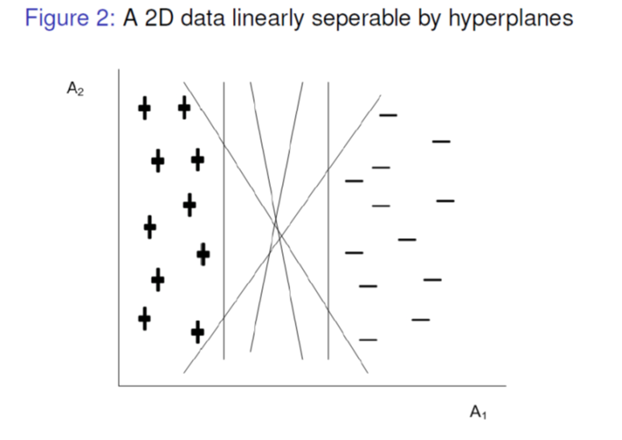
Maximum Margin Hyperplane contd...
Figure 2 shows a plot of data in 2-D. Another simplistic assumption here is that the data is linearly separable, that is, we can find a hyperplane (in this case, it is a straight line) such that all +’s reside on one side whereas all -’s reside on other side of the hyperplane.
From Fig. 2, it can be seen that there are an infinite number of separating lines that can be drawn. Therefore, the following two questions arise:
Whether all hyperplanes are equivalent so far the classification of data is concerned?
If not, which hyperplane is the best?
We may note that so far the classification error is concerned (with training data), all of them are with zero error.
However, there is no guarantee that all hyperplanes perform equally well on unseen (i.e., test) data.

Slide 16
Maximum Margin Hyperplane contd...
Thus, for a good classifier it must choose one of the infinite number of hyperplanes, so that it performs better not only on training data but as well as test data.
To illustrate how the different choices of hyperplane influence the classification error, consider any arbitrary two hyperplanes H1 and H2 as shown in Fig. 3.

Slide 17
Maximum Margin Hyperplane contd...
In Fig. 3, two hyperplanes H1 and H2 have their own boundaries called decision boundaries(denoted as b11 and b12 for H1 and b21 and b22 for H2).
A decision boundary is a boundary which is parallel to hyperplane and touches the closest class in one side of the hyperplane.
The distance between the two decision boundaries of a hyperplane is called the margin. So, if data is classified using Hyperplane H1, then it is with larger margin then using Hyperplane H2.
The margin of hyperplane implies the error in classifier. In other words, the larger the margin, lower is the classification error.
Kharagpur) Data Analytics Autumn 2018 14 / 131

Slide 18
Maximum Margin Hyperplane contd...
Intuitively, the classifier that contains hyperplane with a small margin are more susceptible to model over fitting and tend to classify with weak confidence on unseen data.
Thus during the training or learning phase, the approach would be to search for the hyperplane with maximum margin.
Such a hyperplane is called maximum margin hyperplane and abbreviated as MMH.
We may note the shortest distance from a hyperplane to one of its decision boundary is equal to the shortest distance from the hyperplane to the decision boundary at its other side.
Alternatively, hyperplane is at the middle of its decision boundaries

Slide 19
Linear SVM

Slide 20
Specifying a line and margin
Plus-Plane
“Predict Class = +1” zone
Classifier Boundary
Minus-Plane
“Predict Class = -1” zone
wx+b=1
wx+b=0
wx+b=-1
Plus-plane = { x : w . x + b = +1 }
Minus-plane = { x : w . x + b = -1 }
Classify as.. | +1 | if | w . x + b >= 1
 | -1 | if | w . x + b <= -1
 | Universe explodes | if | -1 < w . x + b < 1

Slide 21
Computing the margin width
M = Margin Width
“Predict Class = +1” zone
How do we compute M in terms of w and b?
“Predict Class = -1” zone
wx+b=1
wx+b=0
wx+b=-1
Plus-plane = { x : w . x + b = +1 }
Minus-plane = { x : w . x + b = -1 }
Claim: The vector w is perpendicular to the Plus Plane. Why?

Slide 22
Computing the margin width
x⁺
M = Margin Width
“Predict Class = +1” zone
How do we compute M in terms of w and b?
x⁻
“Predict Class = -1” zone
wx+b=1
wx+b=0
wx+b=-1
Plus-plane = { x : w . x + b = +1 }
Minus-plane = { x : w . x + b = -1 }
The vector w is perpendicular to the Plus Plane
Let x⁻ be any point on the minus plane
Let x⁺ be the closest plus-plane-point to x⁻.
Any location in ^{m}: not necessarily a datapoint
Any location in R^{m}: not necessarily a datapoint

Slide 23
Computing the margin width
x⁺
M = Margin Width
“Predict Class = +1” zone
x⁻
“Predict Class = -1” zone
wx+b=1
wx+b=0
w . (x ⁻ + λ w) + b = 1
=>
w . x ⁻ + b + λ w .w = 1
=>
-1 + λ w .w = 1
=>
wx+b=-1
What we know:
w . x⁺ + b = +1
w . x⁻ + b = -1
x⁺ = x⁻ + λ w
|x⁺ - x⁻ | = M
It’s now easy to get M in terms of w and b

Slide 24
Linear SVM
A SVM which is used to classify data which are linearly separable is called linear SVM.
In other words, a linear SVM searches for a hyperplane with the maximum margin.
This is why a linear SVM is often termed as a maximal margin classifier (MMC).

Slide 25
Finding MMH for a Linear SVM
In the following, we shall discuss the mathematics to find the MMH given a training set.
In our discussion, we shall consider a binary classification problem consisting of n training data.
Each tuple is denoted by (Xi ,Yi ) where Xi = (xi1,xi2.......xim) corresponds to the attribute set for the ith tuple (data in m-dimensional space) and Yi [+,-] denotes its class label.
Note that choice of which class should be labeled as + or – is arbitrary. Thus, given f(Xi ;Yi )i=1, we are to obtain a hyperplane which separates all Xi into two sides of it (of course with maximum gap).
Before, going to a general equation of a plane in n-dimension, let us consider first, a hyperplane in 2-D plane.

Slide 26
Equation of a hyperplane in 2-D
Let us consider a 2-D training tuple with attributes A1 and A2 as X =(x1,x2), where x1 and x2 are values of attributes A1 and A2, respectively for X.
Equation of a plane in 2-D space can be written as
w0 + w1x1 + w2x2 = 0 [e.g., ax + by + c = 0]
where w0, w1, and w2 are some constants defining the slope and intercept of the line.
Any point lying above such a hyperplane satisfies
w0 + w1x1 + w2x2 > 0 ------------------------ (1)
Similarly, any point lying below the hyperplane satisfies
w0 + w1x1 + w2x2 < 0 ----------------------------- (2)
An SVM hyperplane is an n-dimensional generalization of a straight line in 2-D.
It can be visualized as a plane surface in 3-D, but it is not easy to visualize when dimensionality is greater than 3!

Slide 27
Equation of a hyperplane
In fact, Euclidean equation of a hyperplane in Rm is
w1x1 + w2x2 + ………. + wmxm = b ---------------(3)
where wi ’s are the real numbers and b is a real constant (called the intercept, which can be positive or negative).
In matrix form, a hyperplane thus can be represented as
W.X + b = 0 -----------------------------(4)
where W =[w1,w2.......wm] and X = [x1,x2.......xm] and b is a real constant.
Here, W and b are parameters of the classifier model to be evaluated given a training set D.

Slide 28
Finding a hyperplane
Let us consider a two-dimensional training set consisting two classes + and - as shown in Fig. 4.
Suppose, b1 and b2 are two decision boundaries above and below a hyperplane, respectively.
Consider any two points X+ and X_ as shown in Fig. 4.
For X+ located above the decision boundary, the equation can be written as
W.X+ + b = K where K > 0 ---------------- (5)

Slide 29
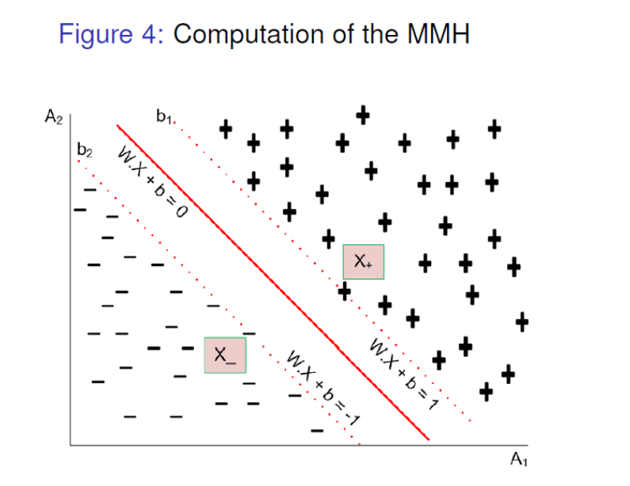
Finding a hyperplane
Similarly, for any point X located below the decision boundary, the equation is
W.X + b = K where K < 0 -----(6)
Thus, if we label all +’s are as class label + and all -’s are class label -, then we can predict the class label Y for any test data X as
Y = + if W:X + b > 0
Y= - if W:X + b < 0

Slide 30
Hyperplane and Classification
Note that W.X + b = 0, the equation representing hyperplane can be interpreted as follows.
Here, W represents the orientation and b is the intercept of the hyperplane from the origin.
If both W and b are scaled (up or down) by dividing a non zero constant, we get the same hyperplane.
This means there can be infinite number of solutions using various scaling factors, all of them geometrical representing the same hyperplane.

Slide 31
Hyperplane and Classification
To avoid such a confusion, we can make W and b unique by adding a constraint that W.X + b = ±1 for data points on boundary of each class.
It may be noted that W.X + b = ± 1 represents two hyperplane parallel to each other.
For clarity in notation, we write this as W.X + b = ± 1.
Having this understating, now we are in the position to calculate the margin of a hyperplane.

Slide 33
Calculating Margin of a Hyperplane

Slide 34
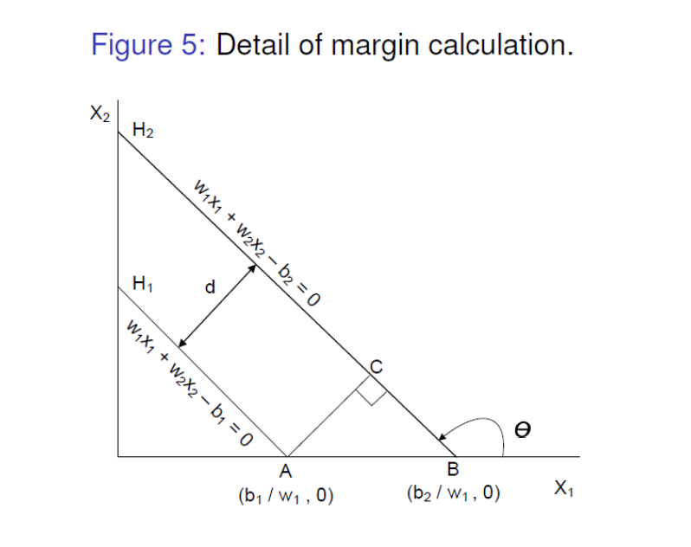
Calculating Margin of a Hyperplane
We calculate the margin more mathematically, as in the following.
Consider two parallel hyperplanes H1 and H2 as shown in Fig. 5. Let the equations of hyperplanes be
H1 : w1x1 + w2x2 - b1 = 0 ------------------------(11)
H2 : w1x1 + w2x2 - b2 = 0 ---------------------------(12)
To draw a perpendicular distance d between H1 and H2, we draw a right-angled triangle ABC as shown in Fig.5.

Slide 35

Calculating Margin of a Hyperplane

Slide 36
Calculating Margin of a Hyperplane

Slide 37
The training phase of SVM involves estimating the parameters W and b for a hyperplane from a given training data.
The parameters must be chosen in such a way that the following two inequalities are satisfied.
W.xi + b ≥ 1 if yi = 1 ------------(13)
W.xi + b ≤1 if yi = -1 ---------- (14)
These conditions impose the requirements that all training tuples from class Y = + must be located on or above the hyperplane
W.x + b = 1, while those instances from class Y = - must be located on or below the hyperplane W.x + b = -1 (also see Fig. 4).

Slide 38
Learning for a Linear SVM
Both the inequalities can be summarized as
Yi (W.x1 + b) ≥ 1 i = 1, 2,……… n ------(15)
Note that any tuples that lie on the hyperplanes H1 and H2 are
called support vectors.
Essentially, the support vectors are the most difficult tuples to
classify and give the most information regarding classification.
In the following, we discuss the approach of finding MMH and the
support vectors.
The above problem is turned out to be an optimization problem, that is, to maximize

Slide 39
Searching for MMH

Slide 41
Searching for MMH
The above stated constrained optimization problem is popularly known as convex optimization problem, where objective function is quadratic and constraints are linear in the parameters W and b.
The well known technique to solve a convex optimization problem is the standard Lagrange Multiplier method.
First, we shall learn the Lagrange Multiplier method, then come back to the solving of our own SVM problem.

Slide 42
Lagrange Multiplier Method
The Lagrange multiplier method follows two different steps depending on type of constraints.
1 Equality constraint optimization problem: In this case, the problem is of the form:
minimize f (x1, x2, ………….. xd )
subject to gi (x) = 0; i = 1, 2, ……………… p
2 Inequality constraint optimization problem: In this case, the problem is of the form:
minimize f (x1, x2, ………….. xd )
subject to hi (x) ≤ 0; i = 1, 2, ……………… p

Slide 43
LMM to Solve Linear SVM
The optimization problem for the linear SVM is inequality constraint optimization problem.
The Lagrangian multiplier for this optimization problem can be written as
where the parameters λ s are the Lagrangian multipliers, and
W = [w1;w2………wm] and b are the model parameters.
Debasis

Slide 44
Lagrange Multiplier Method

Slide 45
Lagrange Multiplier Method

Slide 46
Lagrange Multiplier Method

Slide 47
Lagrange Multiplier Method
Inequality constraint optimization problem solving
The method for solving this problem is quite similar to the Lagrange multiplier method described above.
It starts with the Lagrangian
In addition to this, it introduces additional constraints, called Karush-Kuhn-Tucker (KKT) constraints,

Slide 48
Lagrange Multiplier Method

Slide 49
Lagrange Multiplier Method

Slide 50
Lagrange Multiplier Method

Slide 51
Lagrange Multiplier Method

Slide 52
Lagrange Multiplier Method

Slide 53
LMM to Solve Linear SVM

Slide 54
LMM to Solve Linear SVM
We first solve the above set of equations to find all the feasible solutions.
Then, we can determine optimum value of µ(W, b).
Note:
Lagrangian multiplier λi must be zero unless the training instance xi satisfies the equation yi (W.xi + b) = 1. Thus, the training tuples with λi > 0 lie on the hyperplane margins and hence are support vectors.
The training instances that do not lie on the hyperplane margin have λi = 0.

Slide 55
Classifying a test sample using Linear SVM
For a given training data, using SVM principle, we obtain MMH in the form of W, b and i ’s. This is the machine (i.e., the SVM).
Now, let us see how this MMH can be used to classify a test tuple say X. This can be done as follows.

Slide 56
Classifying a test sample using Linear SVM
This is famously called as “Representer Theorem” which states that the solution W always be represented as a linear combination of training data.

Slide 57
Classifying a test sample using Linear SVM
The above involves a dot product of xi :X, where xi is a support vector (this is so because (λi ) = 0 for all training tuples except the support vectors), we can check the sign of (X).
If it is positive, then X falls on or above the MMH and so the SVM predicts that X belongs to class label +. On the other hand, if the sign is negative, then X falls on or below MMH and the class prediction is -.
Note:
Once the SVM is trained with training data, the complexity of the classifier is characterized by the number of support vectors.
Dimensionality of data is not an issue in SVM unlike in other classifier.

Slide 58
Illustration : Linear SVM

Slide 59
Consider the case of a binary classification starting with a training data of 8 tuples as shown in Table 1.
Using quadratic programming, we can solve the KKT constraints to obtain the Lagrange multipliers λi for each training tuple, which is shown in Table 1.
Note that only the first two tuples are support vectors in this case.
Let W = (w1,w2) and b denote the parameter to be determined now. We can solve for w1 and w2 as follows:

Slide 60
Illustration : Linear SVM

Slide 61
Illustration : Linear SVM

Slide 62
Illustration : Linear SVM

Slide 63
Classification of Multiple-class Data
In the discussion of linear SVM, we have limited to binary classification (i.e., classification with two classes only).
Note that the discussed linear SVM can handle any n-dimension, n 2. Now, we are to discuss a more generalized linear SVM to classify n-dimensional data belong to two or more classes.
There are two possibilities: all classes are pairwise linearly separable, or classes are overlapping, that is, not linearly separable.
If the classes are pair wise linearly separable, then we can extend the principle of linear SVM to each pair. There are two strategies:
One versus one (OVO) strategy
One versus all (OVA) strategy

Slide 64
Multi-Class Classification: OVO Strategy
In OVO strategy, we are to find MMHs for each pair of classes.
Thus, if there are n classes, then nc2 pairs and hence so many classifiers possible (of course, some of which may be redundant).
Also, see Fig. 7 for 3 classes (namely +, - and ). Here, Hxy denotes MMH between class labels x and y.
Similarly, you can think for 4 classes (namely +, -, *,÷ ) and more
Note:
The linear SVM that is used to classify multi-class data fails, if all classes are not linearly separable.
If one class is linearly separable to remaining other classes and test data belongs to that particular class, then only it classifies accurately

Slide 66
Linear SVM for Linearly Not Separable Data
Suppose, X1 and X2 are two instances.
We see that the hyperplane H1 classifies wrongly both X1 and X2.
Also, we may note that with X1 and X2, we could draw another hyperplane namely H2, which could classify all training data correctly.
However, H1 is more preferable than H2 as H1 has higher margin compared to H2 and thus H1 is less susceptible to over fitting.
In other words, a linear SVM can be refitted to learn a hyperplane that is tolerable to a small number of non-separable training data.
The approach of refitting is called soft margin approach (hence, the SVM is called Soft Margin SVM), where it introduces slack variables to the inseparable cases.
More specifically, the soft margin SVM considers a linear SVM hyperplane (i.e., linear decision boundaries) even in situations where the classes are not linearly separable.
The concept of Soft Margin SVM is presented in the following slides.

Slide 67
Soft Margin SVM
Recall that for linear SVM, we are to determine a maximum margin hyperplane W.X + b = 0 with the following optimization:
In soft margin SVM, we consider the similar optimization technique except that a relaxation of inequalities, so that it also satisfies the case of linearly not separable data.

Slide 68
Soft Margin SVM
To do this, soft margin SVM introduces slack variable (ξ), a positive-value into the constraint of optimization problem.
Thus, for soft margin we rewrite the optimization problem as follows.
Thus, in soft margin SVM, we are to calculate W, b and ξ is as a solution to learn SVM.

Slide 69
Soft Margin SVM : Interpretation of ξ
Let us find an interpretation of , the slack variable in soft margin SVM. For this consider the data distribution shown in the Fig. 11.

Slide 70
Soft Margin Classification
Sec. 15.2.1
If the training data is not linearly separable, slack variables ξ_{i} can be added to allow misclassification of difficult or noisy examples.
Allow some errors
Let some points be moved to where they belong, at a cost
Still, try to minimize training set errors, and to place hyperplane “far” from each class (large margin)
ξ_{i}
ξ_{j}

Slide 72
Soft Margin SVM : Interpretation of ξ
The data X is one of the instances that violates the constraints to be satisfied for linear SVM.
Thus, W.X + b = -1+ξ represents a hyperplane that is parallel to the decision boundaries for class - and passes through X.
It can be shown that the distance between the hyperplanes is
In other words, provides an estimate of the error of decision boundary on the training example X.

Slide 73
Soft Margin SVM : Interpretation of ξ
In principle, Eqn. 25 and 26 can be chosen as the optimization problem to train a soft margin SVM.
However, the soft margin SVM should impose a constraint on the number of such non linearly separable data it takes into account.
This is so because a SVM may be trained with decision boundaries with very high margin thus, chances of misclassifying many of the training data.
This is explained in Fig. 12. Here, if we increase margin further, then P and Q will be misclassified.
Thus, there is a trade-off between the length of margin and training error. The cost parameter in the SVM means: The tradeoff between misclassification and simplicity of the model

Slide 74
Soft Margin SVM : Interpretation of ξ
To avoid this problem, it is therefore necessary to modify the objective function, so that penalizing for margins with a large gap, that is, large values of slack variables.
The modified objective function can be written as

Slide 75
Solving for Soft Margin SVM

Slide 77


Slide 78
Solving for Soft Margin SVM

Slide 79
Solving for Soft Margin SVM

Slide 82
SVM Testing

Slide 83
SVM classification for non separable data
Such a linearly not separable data can be classified using two approaches.
1 Linear SVM with soft margin
2 Non-linear SVM
In the following, we discuss the extension of linear SVM to classify linearly not separable data.
We discuss non-linear SVM in detail later.
If the number of training data instances violating linear separability is less, then we can use linear SVM classifier to classify them.
The rational behind this approach can be better understood from Fig. 10.
Kharagpur) Data A 018 72 / 131

Slide 84
Non-Linear SVM
SVM classification for non separable data
Figure 9 shows a 2-D views of data when they are linearly separable and not separable.
In general, if data are linearly separable, then there is a hyperplane otherwise no hyperplane.

Slide 85
Non-Linear SVM
Linear SVM undoubtedly better to classify data if it is trained by linearly separable data.
Linear SVM also can be used for non-linearly separable data, provided that number of such instances is less.
However, in real life applications, number of data overlapping is so high that soft margin SVM cannot cope to yield accurate classifier.
As an alternative to this there is a need to compute a decision boundary, which is not linear (i.e., not a hyperplane rather hypersurface).
Note that a linear hyperplane is expressed as a linear equation in terms of n-dimensional component, whereas a non-linear hypersurface is a non-linear expression.

Slide 87
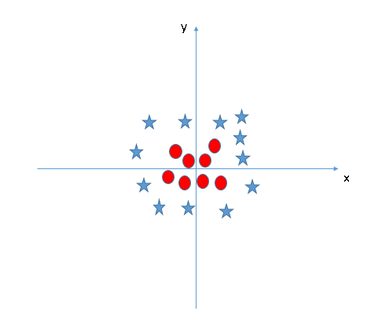
Find the hyperplane to segregate to classes (Scenario-5)
In the scenario below, we can’t have linear hyperplane between the two classes, so how does SVM classify these two classes? Till now, we have only looked at the linear hyperplane.
SVM can solve this problem. It solves this problem by introducing additional feature. Here, we will add a new feature z=x²+y².

Slide 88
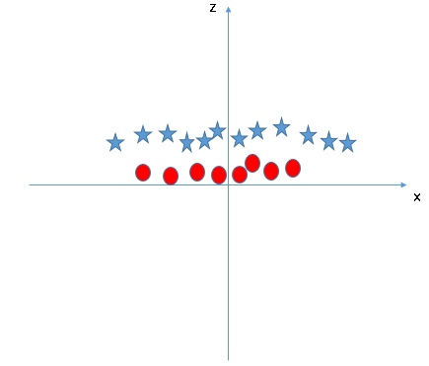
Scenario-5
Now, let’s plot the data points on axis x and z:
In above plot, points to consider are:
All values for z would be positive always because z is the squared sum of both x and y
In the original plot, red circles appear close to the origin of x and y axes, leading to lower value of z and star relatively away from the origin result to higher value of z.

Slide 89
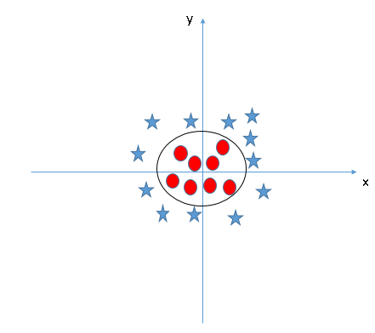
In SVM, it is easy to have a linear hyperplane between these two classes. But, another burning question which arises is, should we need to add this feature manually to have a hyperplane.
SVM has a technique called the kernel trick. These are functions which takes low dimensional input space and transform it to a higher dimensional space i.e. it converts not separable problem to separable problem, these functions are called kernels.
It is mostly useful in non-linear separation problem. Simply put, it does some extremely complex data transformations, then find out the process to separate the data based on the labels or outputs you’ve defined.
When we look at the hyperplane in original input space it looks like a circle:

Slide 90
Non-Linear SVM
A hyperplane is expressed as linear : w1x1 + w2x2 + w3x3 + c = 0 ----------------(30)
Whereas a non-linear hypersurface is expressed as.
The task therefore takes a turn to find a nonlinear decision boundaries, that is, nonlinear hypersurface in input space comprising with linearly not separable data.
This task indeed neither hard nor so complex, and fortunately can be accomplished extending the formulation of linear SVM, we have already learned.

Slide 91
Non-Linear SVM
This can be achieved in two major steps.
1 Transform the original (non-linear) input data into a higher dimensional space (as a linear representation of data). Note that this is feasible because SVM’s performance is decided by number of support vectors (i.e., training data) not by the dimension of data.
2 Search for the linear decision boundaries to separate the transformed higher dimensional data.
The above can be done in the same line as we have done for linear SVM.
In nutshell, to have a nonlinear SVM, the trick is to transform non-linear data into higher dimensional linear data.
This transformation is popularly called non linear mapping or attribute transformation. The rest is same as the linear SVM.

Slide 92
Concept of Non-Linear Mapping
In order to understand the concept of non-linear transformation of original input data into a higher dimensional space, let us consider a non-linear second order polynomial in a 3-D input space.

Slide 93
Concept of Non-Linear Mapping
The transformed form of linear data in 6-D space will look like.
Z : w1z1 + w2z2 + w3z3 + w4z4 + w5z5 + w6x1z6 + c
Thus, if Z space has input data for its attributes x1; x2; x3 (and hence Z’s values), then we can classify them using linear decision boundaries.
Example: Non-linear mapping to linear SVM
The below figure shows an example of 2-D data set consisting of class label +1 (as +) and class label -1 (as -).

Slide 94
Concept of Non-Linear Mapping
All instances of class -1 can be separated from instances of class +1 by a circle, The following equation of the decision boundary can be thought of:
Example: Non-linear mapping to linear SVM
We see that

Slide 95
Concept of Non-Linear Mapping

Slide 96
Concept of Non-Linear Mapping

Slide 97
Non-Linear to Linear Transformation: Issues Non-Linear to Linear Transformation: Issues
The non linear mapping and hence a linear decision boundary
concept looks pretty simple. But there are many potential
problems to do so.
1 Mapping: How to choose the non linear mapping to a higher
dimensional space?
In fact, the – Ø transformation works fine for small example.
But, it fails for realistically sized problems.
2 Cost of mapping: For n-dimensional input instances there exist
different monomials comprising a feature space dimensionality NH. Here, d is the maximum degree of monomial

Slide 98
Non-Linear to Linear Transformation: Issues
Dimensionality problem: It may suffer from the curse of dimensionality problem often associated with a high dimensional data.
More specifically, in the calculation of W.X or Xi :X (in (X) see Eqn. 18), we need n multiplications and n additions (in their dot products) for each of the n-dimensional input instances and support vectors, respectively.
As the number of input instances as well as support vectors are enormously large, it is therefore, computationally expensive.
Computational cost: Solving the quadratic constrained optimization problem in the high dimensional feature space is too a computationally expensive task.

Slide 99
Non-Linear to Linear Transformation: Issues
Fortunately, mathematicians have cleverly proposes an elegant solution to the above problems.
Their solution consist of the following:
1 Dual formulation of optimization problem
2 Kernel trick
In the next few slides, we shall learn about the above-mentioned two topics.

Slide 100
Dual Formulation of Optimization Problem
We have already learned the Lagrangian formulation to find the maximum margin hyperplane as a linear SVM classifier.
Such a formulation is called primal form of the constraint optimization problem.
Primal form of Lagrangian optimization problem is reproduced further

Slide 101
Dual Formulation of Optimization Problem
The primal form of the above mentioned inequality constraint optimization problem(according to Lagrange multiplier method) is given by
This Lp is called the primal form of the Lagrangian optimization problem.

Slide 102
Dual Formulation of Optimization Problem
The dual form of the same problem can be derived as follows.
To minimize the Lagrangian, we must take the derivative of Lp with respect to W, b and set them to zero.

Slide 103
Dual Formulation of Optimization Problem

Slide 104
Dual Formulation of Optimization Problem
There are key differences between primal (Lp) and dual (LD) forms of Lagrangian optimization problem as follows.
1 Lp involves a large number of parameters namely W, b and i ’s. On the other hand, LD involves only i ’s, that is, Lagrange multipliers.
2 Lp is the minimization problem as the quadratic term is positive. However, the quadratic term in LD is negative sign, Hence it is turned out to be a maximization problem.
3 Lp involves the calculation of W:x, whereas LD involves the calculation of xi :xj . This, in fact, advantageous, and we will realize it when we learn Kernel-based calculation.

Slide 105
Dual Formulation of Optimization Problem

Slide 106
Kernel Trick
We have already covered an idea that training data which are not linearly separable, can be transformed into a higher dimensional feature space such that in higher dimensional transformed space a hyperplane can be decided to separate the transformed data and hence original data(also see Fig.16).
Clearly the data on the left in the figure is not linearly separable.
Yet if we map it to a 3D space using and the mapped data, then it is possible to have a decision boundaries and hence hyperplane in 3D space.

Slide 107
Kernel Trick

Slide 108
Kernel Trick

Slide 109
Kernel Trick

Slide 110
Kernel Trick

Slide 111
Kernel Trick

Slide 112
Kernel Trick
Now, question here is how to choose , the mapping function X ) Z, so that linear SVM can be directly applied to.
A breakthrough solution to this problem comes in the form of a method as the kernel trick.
We discuss the kernel trick in the following.
We know that (.) dot product is often regarded as a measure of
similarity between two input vectors.

Slide 113
Kernel Trick

Slide 114
Kernel Trick

Slide 115
Kernel Trick

Slide 116
Kernel Trick :

Slide 117
Kernel Trick : Significance

Slide 118
Kernel Trick : Significance
Computational efficiency:
Another important significance is easy and efficient computability.
We know that in the discussed SVM classifier, we need several and repeated round of computation of dot products both in learning phase as well as in classification phase.
On other hand, using kernel trick, we can do it once and with fewer dot products.
This is explained in the following.

Slide 120
Kernel Trick : Significance

Slide 121
Kernel Functions

Slide 122
Kernel Functions : Example

Slide 123
Kernel Functions : Example
Different kernel functions follow different parameters. Those parameters are called magic parameters and to be decided a priori.
Further, which kernels to be followed also depends on the pattern of data as well as prudent of user.
In general, polynomial kernels result in a large dot products, Gaussian RBF produces more support vectors than other kernels.
To have an intuitive idea of kernels to be used in non-linear data handling is shown in Fig. 17.

Slide 124
Kernel Functions : Example

Slide 125
Why are SVMs fast?
1.Quadratic optimization (convex!)
2. They work in the dual, with relatively few points
3. The kernel trick
Why are SVMs often more accurate than logistic regression?
1. SVMs use kernels –but regression can, too
2.SVMs assume less about the model form
3. Logistic regression uses all the data points, assuming a probabilistic model, while SVMs ignore
the points that are clearly correct, and give less weight to ones that are wrong

Slide 126
Characteristics of SVM 1Characteristics of SVM
The SVM learning problem can be formulated as a convex optimization problem, in which efficient algorithms are available to find the global minimum of the objective function.
Other methods namely rule based classifier, ANN classifier etc. find only local optimum solutions.
SVM is the best suitable to classify both linear as well as non-linear training data efficiently.
SVM can be applied to categorical data by introducing a suitable similarity measures.
Computational complexity is influenced by number of training data not the dimension of data. In fact, learning is a bit computationally heavy and hence slow, but classification of test is extremely fast and accurate.

Slide 127
Main Ideas
Max-Margin Classifier
Formalize notion of the best linear separator
Lagrangian Multipliers
Way to convert a constrained optimization problem to one that is easier to solve
Kernels
Projecting data into higher-dimensional space makes it linearly separable
Complexity
Depends only on the number of training examples, not on dimensionality of the kernel space!

Slide 128
Overtraining/overfitting
A well known problem with machine learning methods is overtraining.
This means that we have learned the training data very well, but
we can not classify unseen examples correctly.
An example: A botanist really knowing trees.Everytime he sees a new tree,
he claims it is not a tree.
=-1
=+1

Slide 129
Overtraining/overfitting 2
A measure of the risk of overtraining with SVM (there are also other
measures).
It can be shown that: The portion, n, of unseen data that will be missclassified is bounded by:
n ≤ Number of support vectors / number of training examples
Ockham´s razor principle: Simpler system are better than more complex ones.
In SVM case: fewer support vectors mean a simpler representation of the hyperplane.
Example: Understanding a certain cancer if it can be described by one gene
is easier than if we have to describe it with 5000.
Notes:
Example with a gardener.

